Slide 1

British Airways
FOR PURPOSES OF FORAGE VIRTUAL WORK EXPERIENCE PROGRAM
Predictive Model and its Results
2023-01-06

Slide 2
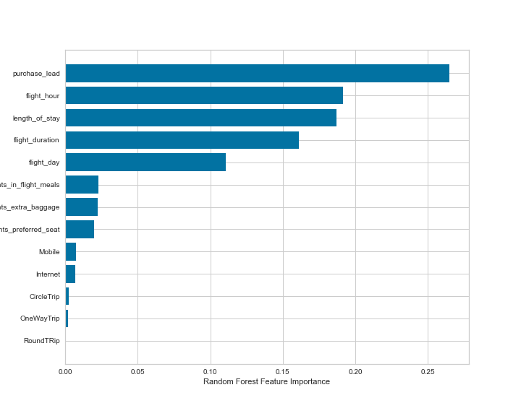
FOR PURPOSES OF FORAGE VIRTUAL WORK EXPERIENCE PROGRAM
Predictive Model Results
Recall Rate
59%
Precision
61%
Chance of predicting true successful bookings.
Will be predicted as actually completed bookings out of all successfully completed bookings.
66% Chance of predicting true incomplete bookings correctly.
Accuracy of the model predicting successful or incomplete booking is
Accuracy
62%
We are concerned with not predicting the successful bookings correctly. Imbalance dataset drives higher accuracy but it does not accurately predict the successful bookings.
Dataset was balanced with 8k labelled as incomplete bookings and 7k as complete bookings.
Top features that can drive successful flight bookings

